Slide 1
CloverLeaf3D guided tour
Why we care about this code, and how to use it.
S. Vadlamani
SC2021-AHUG Hackathon Nov. 14, 2021

Slide 2
For the next hour we will …
Start with logistics
Yet another repo to clone.
Quick intro to Cloverleaf(3D)
Review of HowTos
This may be some VIM time
Build
Run
Look at some profiles
Different compilers will be considered
… That will take ~ 30mins
The rest of the time we can work together on the offered machines to get things happening.

Slide 3
Logistics
Please clone: git@github.com:srinathv/sc21-ahug-cloverleaf3D.git
Makefile with aarch64 compilers syntax with choice flags
Some run scripts
Finding good parallel decompactions
Run the Arm Forge Map profiler in different ways
General notes in the Read.me
This presentation
Let’s pause for a quick moment to get the repo on you local and Hack-machines.

Slide 4
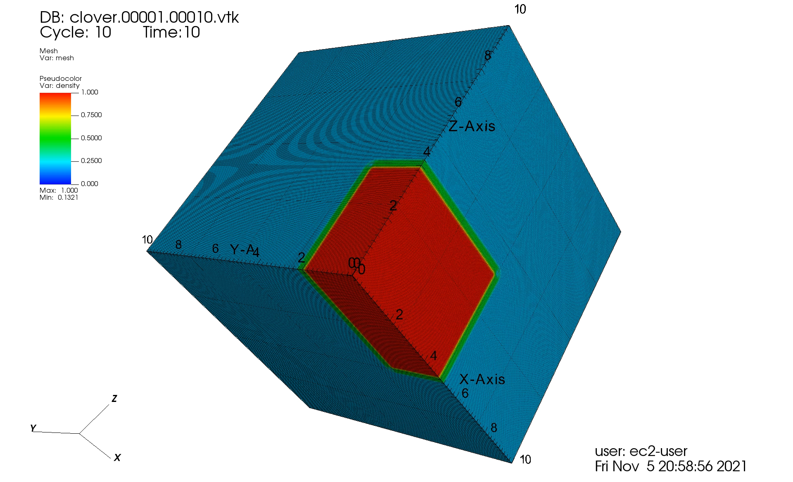
Cloverleaf(3D)
CloverLeaf uses a Lagrangian-Eulerian scheme to solve Euler’s equations of compressible fluid dynamics in two spatial dimensions.
3 moment PDEs
Ideal gas closure
Staggered grid
Energy, density, pressure cell centered
Velocity on node vertices
Explicit finite-volume with second order accuracy
Notes:
Boundaries are reflective, this was a 256^3 problem for 1000 steps, dump every 10 steps
2 density layers Visualization created by Olly Perks

Slide 5
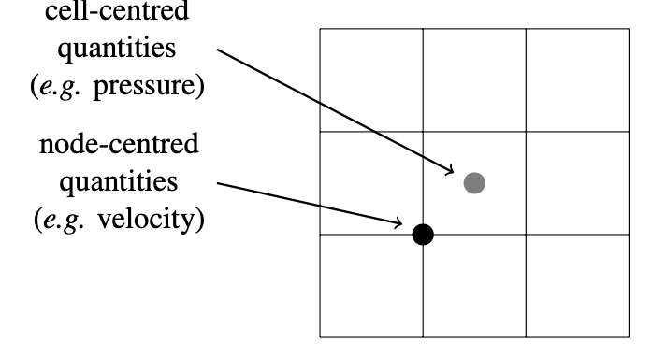
What happens at each iteration?
a Lagrangian step advances the solution in time using a predictor-corrector scheme, with the cells becoming distorted as the nodes move due to the fluid flow;
an advection step restores the cells to their original positions by moving the nodes back,
and calculating the amount of material that has passed through each cell. This is accomplished using two sweeps, one in the horizontal dimension and the other in the vertical.

Slide 6
Parallel Decomposition
Computational mesh is spatially decomposed and distributed across processes within the application, in a manner which attempts to minimize the communication surface area between processes.
Data that is required for the various computational steps and is non-local to a particular process is stored in outer layers of “halo” cells within each process.
Data exchanges occur mainly between immediate neighboring processes (vertically and horizontally), within the decomposition.
A global reduction operation is required by the algorithm during the calculation of the timestep value, which is calculated once per iteration.

Slide 7
Cloverleaf was created to get Exascale right
Want evaluate five candidate programming models for future exascale applications (MPI, MPI+OpenMP, MPI+OpenACC, MPI+CUDA and CAF) used in developed Lagrangian-Eulerian explicit hydrodynamics codes
https://github.com/UK-MAC/CloverLeaf3D points to different repos of implementation
https://github.com/UK-MAC larger collection of mini-apps used for evaluations of methods
Used by Atomic Weapons Establishment (AWE) for an exescale readiness endeavor
Demonstrates both weak and strong scaling for different parallelism implementations.
Bonus: Uses Fortran!!!

Slide 8
HowTos
Get the code:
$git clone git@github.com:UK-MAC/CloverLeaf3D_ref.git
$git checkout v1.1
Build And Run
Refer to https://gitlab.com/arm-hpc/packages/-/wikis/packages/cloverleaf3d
For build and run instructions
$ make COMPILER=<ARM,FUJITSU,PGI (for nvidia),GNU>
$ Ex. Run command : export OMP_NUM_THREADS=2 && mpirun –n 32 ./clover_leaf
INPUT file: clover.in in same directory as exe: clover_leaf
Also use git@github.com:srinathv/sc21-ahug-cloverleaf3D.git
This Makefile has ACFL, Fujistu and the Nvidia considerations
The repo also has some run scripts that we can address after the presentation.

Slide 9
Profiling
Worth while to see what happens with different compilers
Find bottle necks
Worthwhile reading about Neoverse-N1 considerations for performance:
https://armkeil.blob.core.windows.net/developer/Files/pdf/white-paper/neoverse-n1-core-performance-v2.pdf

Slide 10
What is Frontend for CPU
The Front End of the CPU is an in-order pipeline that handles fetching instructions from the I-Cache, decoding those instructions, and queuing them for the execution engine in the Back End.
The architectural instructions can get broken down into micro-operations in the decode stage. These micro-operations are queued and dispatched to the execution engines according to their availability.
Apart from the fetch, decode and dispatch units, there is a rename block that keeps track of the operational dataflow and dependencies to make sure that the executed operations are committed in-order.
Another important unit in the Front End is the Branch Predictor. This unit predicts both the direction of branches as well as target addresses for indirect branches.
Note that an out of order processor can fetch multiple instructions in advance to fill the pipeline and execute them speculatively.
Branch prediction techniques help with fetching the instructions in the right program order as much as possible, as branch mis-predictions lead to pipeline flushes and wasted cycles.
Neoverse N1 can fetch up to 4 instructions per cycle and dispatch a maximum 8 micro- operations per cycle.

Slide 11
CPU Backend
The Back End of the CPU handles the execution of the micro-operations which are dispatched to the relevant execution units for processing.
Many CPUs supports multiple execution units including the Branch unit, Load/Store unit and Arithmetic units including the advanced vector engines.
The number of execution units and cycles taken for the execution of an instruction can vary per micro-architecture; therefore, instruction execution latency and throughput are implementation dependent.
Once instruction execution is complete, the results are stored and committed in-order when dependencies are resolved.
Neoverse N1 has 4 integer execution units, 2 Floating point/SIMD pipelines and 2 load/store pipelines, which allows up to 8 micro-operations to be dispatched into the execution pipeline every cycle.

Slide 12
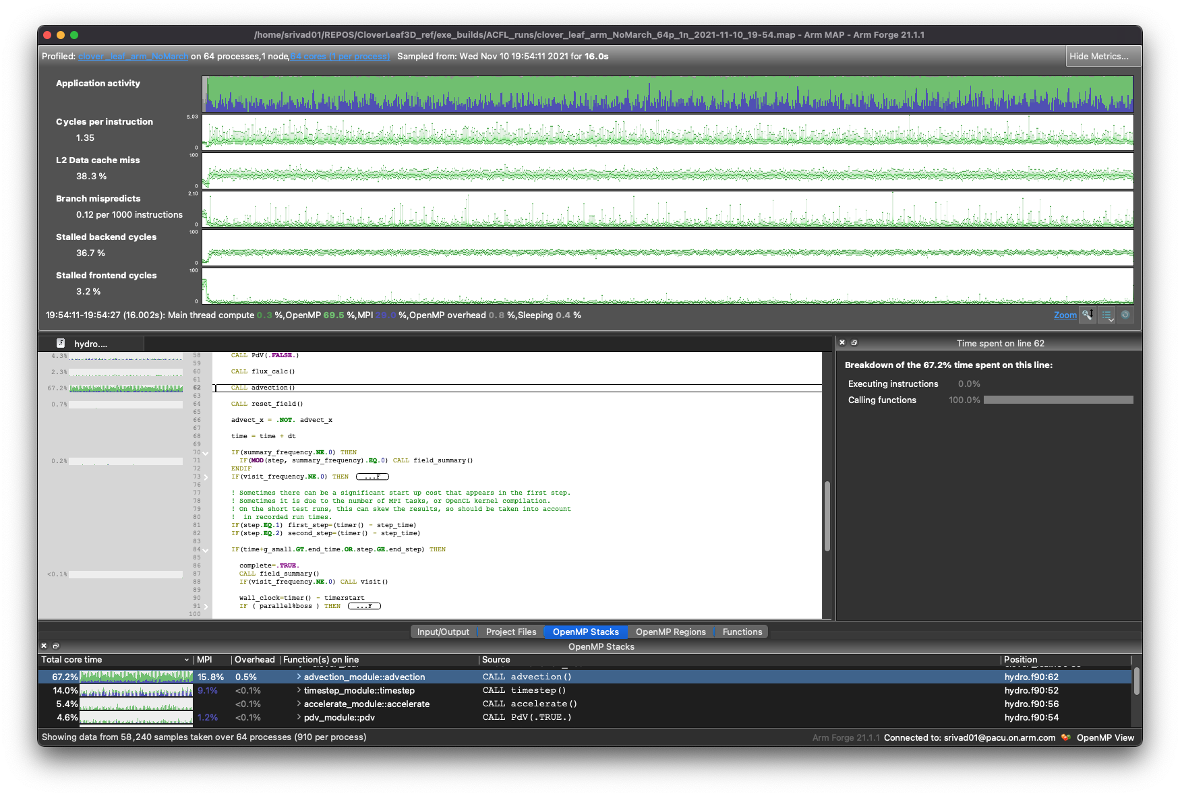
Map profile with default metrics

Slide 13
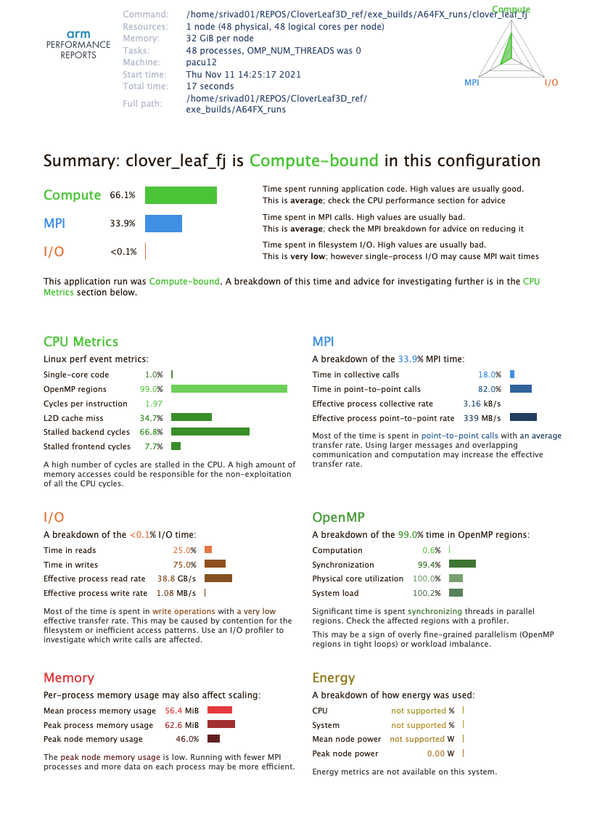
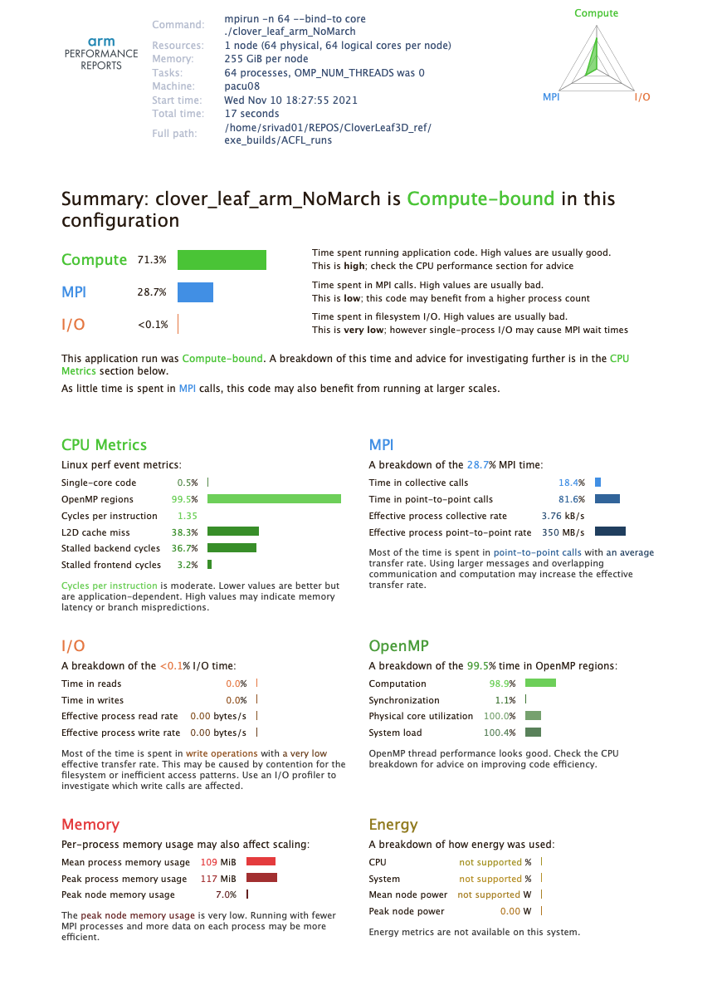
Compute bound
Similar behavior on TX2 and A64FX

Slide 14
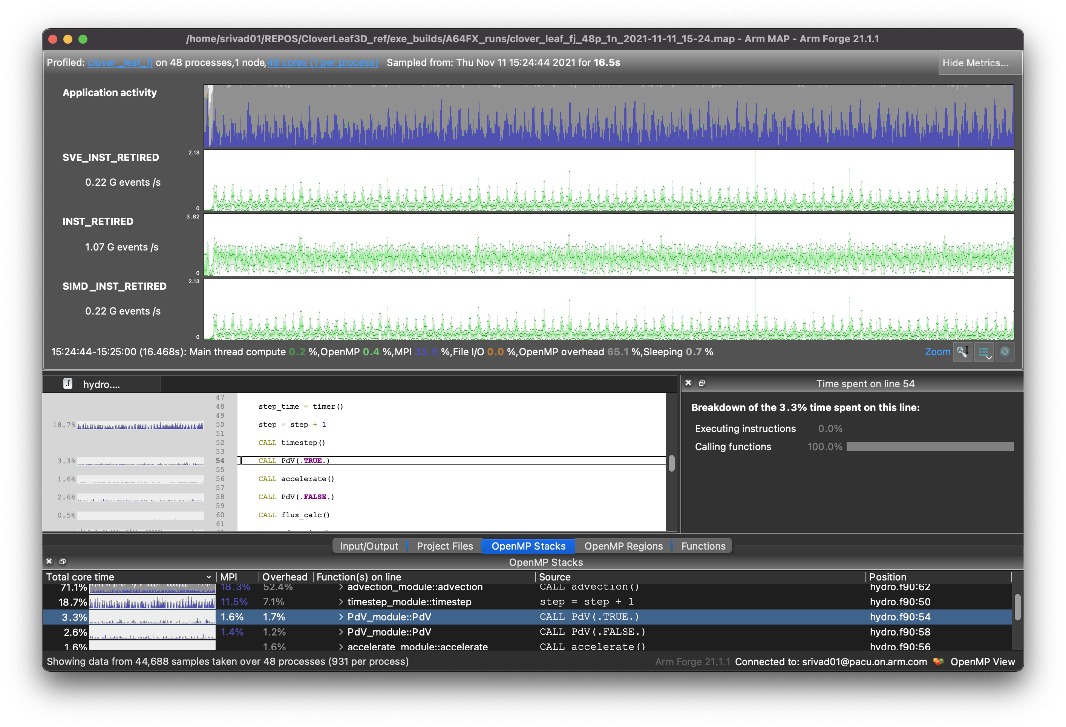
SVE is used on A64FX with possible greater use.

Slide 15
What have we gained …
A better understanding of Cloverleaf the mini-app itself
How to use the code
Methods for using a profiling tool
What now…
Try building and running
S. Vadlamani will be available for the full hour to aid
Contact: srinath.Vadlamani@arm.com
Working with olly.perks@arm.com on reframe files to get some quick to solution action.

